Slide 1

0
WHY VUE ?
1
DATA BINDING
ROADMAP
2
METHODS & EVENTS
3
LOOPS / IF/ELSE
X
VUTIFY
4
COMPUTED & WATCHERS
FINAL
9
AUTHENTICATION
5
CLI
MIDTERM
COMPONENTS
8
SLOTS / WIDGETS
6
7
ROUTING

Slide 2

VUE - CHAPTER 6
COMPONENTS
INJECT

Slide 3


Slide 4


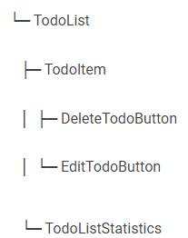
EXPLAIN
VUE Component tree
5 MIN
CLASS
From this mock up…
…We can define this VUE component tree
I have 3 todos
My todo item 1
Delete
Edit
My todo item 1
Delete
Edit
My todo item 1
Delete
Edit
Statistics:
6 TODO with high priority
3 TODO with low priority

Slide 5

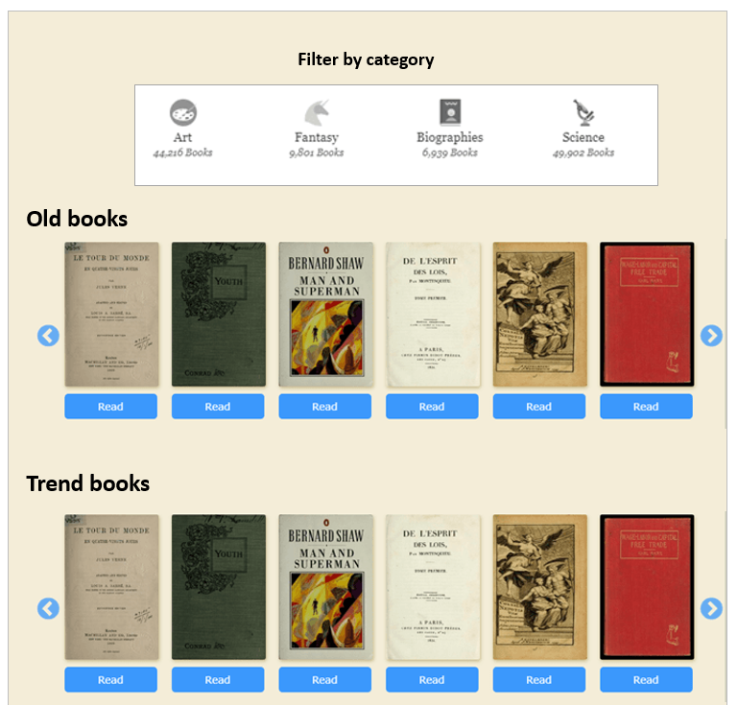
PRACTICE
VUE Component tree
From this mock up…
… define your VUE component tree
30 MIN
TEAM 3

Slide 6
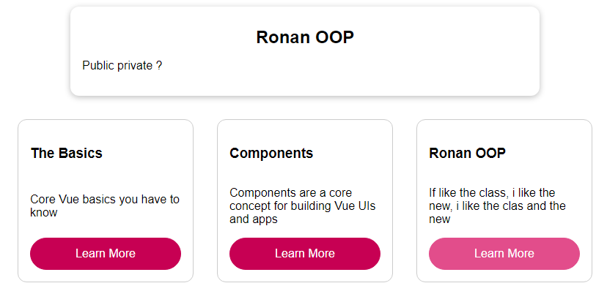
PRACTICE
Activity 1 - Instructions
30 MIN
INDIV
Display full text and title of selected element
click …

Slide 7
Activity 1 - VUE components definition
active-element
knowledge-grid
knowledge-element

Slide 8
Activity 1 - VUE components communication
app
TODO
title
active-element
fulltext
TODO
knowledge-grid
name
knowledge-element
desc
topics
id
select-topic
TODO
TODO
select-topic

Slide 9
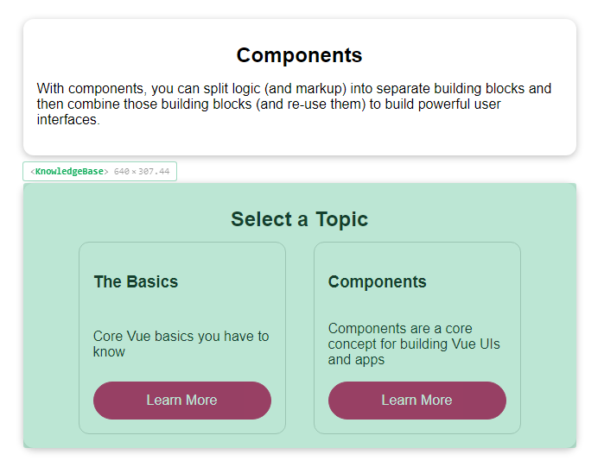
PRACTICE
Activity 2
Add another level of component
15 MIN
INDIV
active-element
knowledge-base
knowledge-grid
knowledge-element

Slide 10
Activity 2 - VUE components communication
app
title
active-element
fulltext
TODO
name
knowledge-base
knowledge-grid
knowledge-element
desc
topics
topics
id
select-topic
select-topic
select-topic

Slide 11
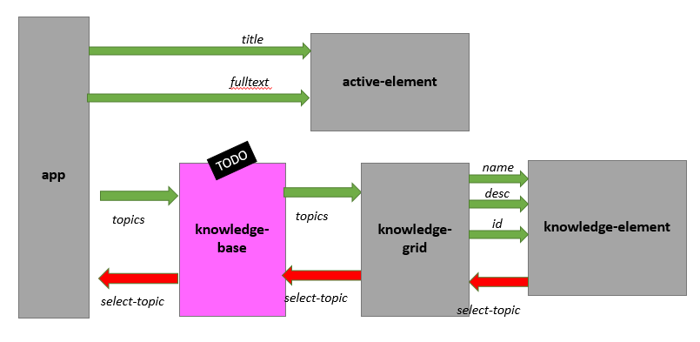
PRACTICE
Activity 3
Instead of props and emit , use INJECT to communicate
Between app and knowledge grid / knowledge element
15 MIN
INDIV

Slide 12
Parent provide
Child inject
FUNCTIONS or DATA
PROVIDE
INJECT

Slide 13
INJECT: HOW DO IT WORK FOR DATA?
1 – On PARENT : Define what you want to provide
My data
provide() {
return {
topics: this.topics,
selectTopic: this.activateTopic
};
},
My data
2 – On CLIDHREN Inject the data or the function you want to use
<script>
export default {
inject: ['selectTopic'],
};
</script>
<template>
<button @click="selectTopic(id)">
</button>
</template>

Slide 14
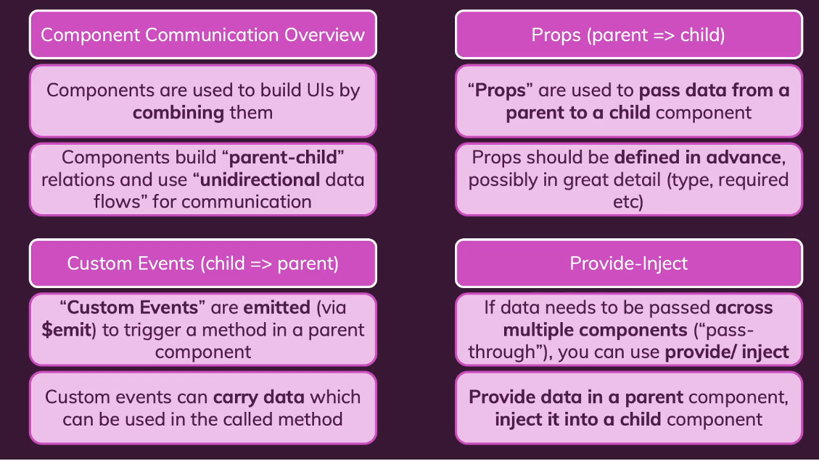
Components communication - summary

Slide 15



HOMEWORK
Implement a component gallery-image
INDIV
To manage the display of an image, given its name and URL and emit event if deleted
Cat
<div class="image">
<h1>Cat</h1>
<img src="https://catURl">
<button class="remove">X</button>
</div>
X
Example of generated HTML
When clicked on X, an event “image-removed” is raised

Slide 16

TO READ DURING THIS CLASS
Maximilian Schwarzmüller. VueJS complete course - UDEMY
https://www.udemy.com/course/vuejs-2-the-complete-guide/learn/lecture/21463426#overview
Vue 3 official document
https://v3.vuejs.org/guide/single-file-component.html#introduction
Vue CLI official document
https://cli.vuejs.org/guide/
A full demo to build a poject (quiz app)
https://www.youtube.com/watch?v=4deVCNJq3qc&ab_channel=freeCodeCamp.org
Code style VueJS3.0
https://v3.vuejs.org/style-guide/

